Slide 1
Project 1: Standardized Test Analysis
Present by Casey Liu

Slide 2
Problem Statement
I am hired by the a local educational consulting company in California. The company provides the service to students and help them get in their ideal colleges. The company asks me to analyze SAT and ACT performance for various districts in California and provide information to the parents, so the parents would know the districts they can send their children to get higher SAT/ACT scores.
The customers (parents) in this company pay great attention to the education of their children. They are willing to spend money on education and relocate to different cities in the state to help the children have better learning environment. This project aims to identify the districts that have good student performance on the SAT/ACT tests (from Grade 12 students). I will be the one who provides the recommendations to the parents.

Slide 3
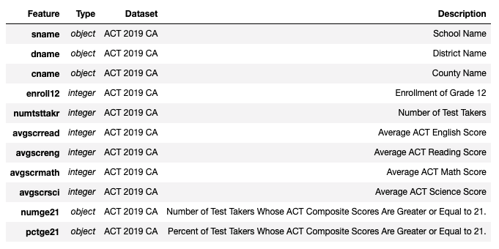
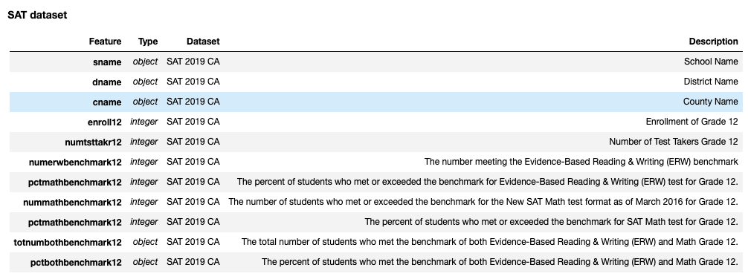
Data Import
act_2019_ca.csv:
2019 ACT Scores in California by School
sat_2019_ca.csv:
2019 SAT Scores in California by School

Slide 4
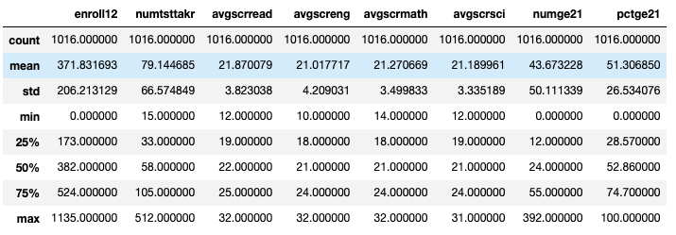
Data Analysis
ACT:
Count = 1016
Test takers mean = 79
Percentage of pass mean = 51%
SAT:
Count: 1198
Test takers mean = 139
Percentage of pass mean = 43%
The average numbers of students who take ACT and SAT are 79 and 139 in California schools.

Slide 5
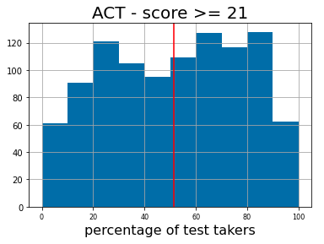
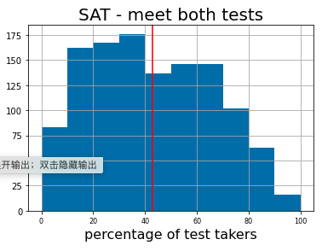
Histogram for percent of students who pass the benchmark
The average numbers of percent of test takers whose ACT or SAT score pass the benchmark are 51% and 43%.

Slide 6
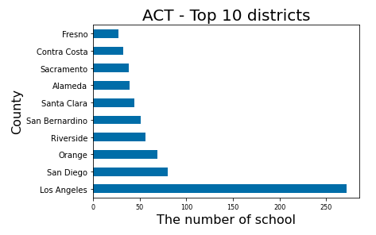
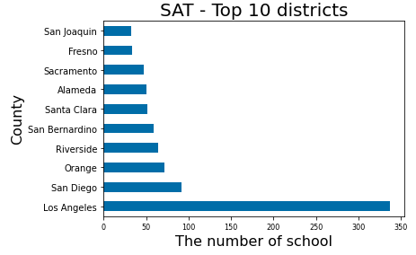
Top 10 districts
Los Angeles is top one district whose students would like to enroll SAT/ACT tests.

Slide 7
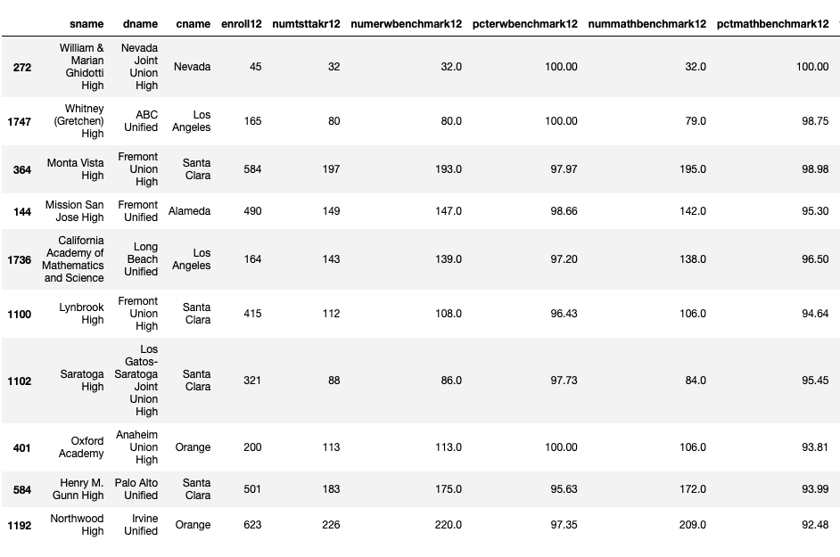
Top 10 schools - SAT

Slide 8
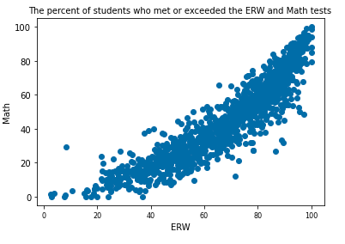
Covariance and correlation —— ERW & Math
We also notice that the performance of SAT ERW test and SAT Math test are highly related. The schools who have high percent of students who meet or exceed the benchmark for ERW are likely to have high percent of students to meet or exceed the benchmark for math.
correlation = 0.914

Slide 9
Conclusions and Recommendations
From the data and analysis we provided above, we can see that Los Angeles is the best county for students to choose if they would like to get higher SAT/ACT scores. Los Angeles not only has the most schools, but also has high percentage of students who met the benchmark of SAT/ACT tests.
In Los Angeles, here are top 5 schools (ACT): Whitney High, Academy of the Canyons, La Canada High, Los Angeles Center for Enriched Studies, Arcadia High.
Here are top 5 schools (SAT): Whitney High, California Academy of Mathematics and Science, La Canada High, San Marino High, South Pasadena Senior High.

